Slide 1

Application Layer (HTTP)
Lecture 2 | CSE421 – Computer Networks
Department of Computer Science and Engineering School of Data & Science

Slide 2
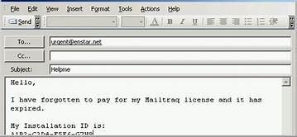

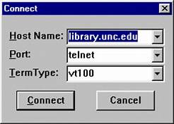
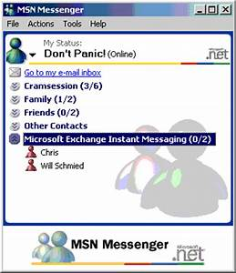



Applications
1970-1980
1990-2000
2000-2020

Slide 3

Objectives
Principles of network applications
Web and HTTP
Electronic Mail (SMTP, POP3, IMAP)
DNS
P2P Applications
Video streaming and content distribution networks

Slide 4
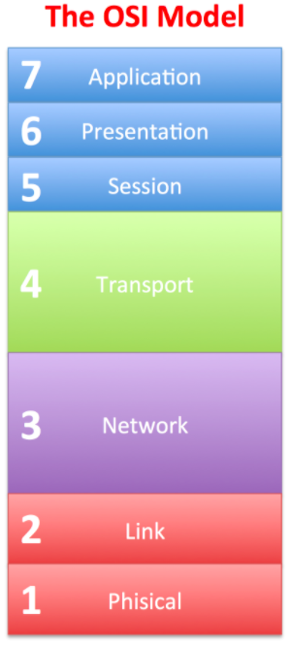
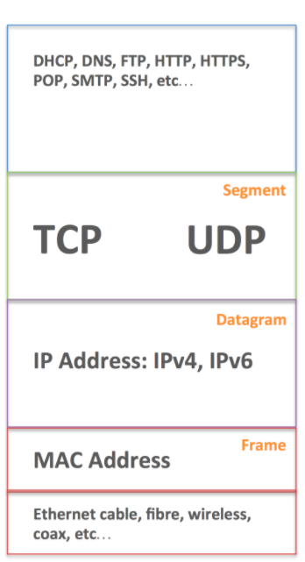
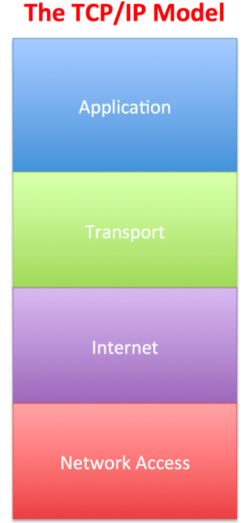
Network Models
Data
Port Numbers
Data Link
Physical

Slide 5
Application Layer
Application Layer Protocols
Provide the rules and formats that govern how data is treated in the application layer.
Application Software
The programs used to communicate over the network.
For example:
When displaying a web page:
The Application Layer uses the HTTP(Hyper Text Transfer Protocol) Protocol.
The Application Software is your Web browser.

Slide 6
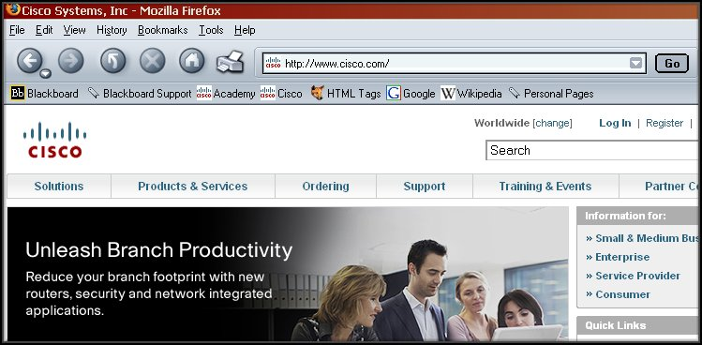
Application Layer

Slide 7
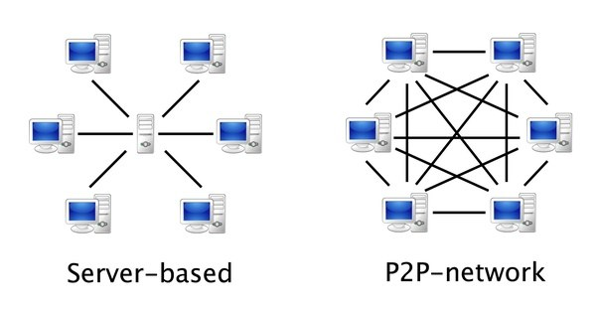
Application Layer
When accessing information on a device, the data may not be physically stored on that device.
If that is the case, a request must be made to the device where the data resides.
Two methods:
Client/Server
Peer-to-Peer (P2P)
Client-Server
Peer-to-Peer(P2P)

Slide 8
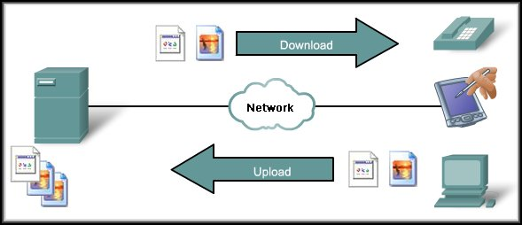
Client/Server Model
May also require control information. User Authentication or identify a file to be transferred.
Clients – hardware, software combination
The client begins the exchange by making a request for data.
The server responds with one or more streams of data.
Resources are stored on the server.

Slide 9
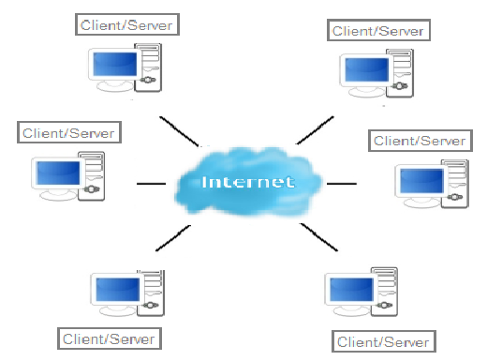
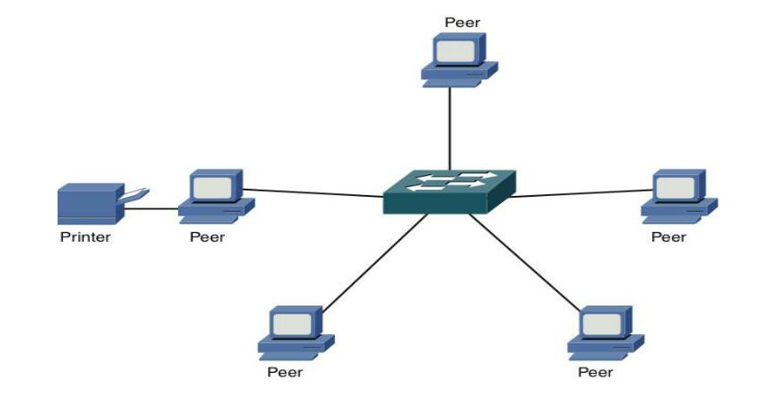
Peer-to-Peer Model
Two or more computers are connected via a network and can share resources (such as printers and files) without having a dedicated server.
End devices (peers) can function as either a server or client depending upon the required service.
Notes:
Every connected end device (known as a peer) can function as either a server or a client.
Peer-to-peer networks decentralize the resources on a network without using a centralized server.
One computer might assume the role of server for one transaction while simultaneously serving as a client for another. The roles of client and server are set on a per request basis.

Slide 10
Web and HTTP
Part 2

Slide 11
Objectives -Part 2
WWW – The Web
HTTP
HTTP Messages and Methods

Slide 12

WWW- The Web
A web page or webpage is a document that is viewed in an Internet browser.
It may contain text, graphics, and hyperlinks to other web pages and files.
A web page consists of objects
Web page consists of base HTML-file which includes several referenced objects
Objects can be HTML file, JPEG image, Java applet, audio file…

Slide 13
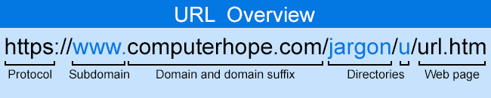
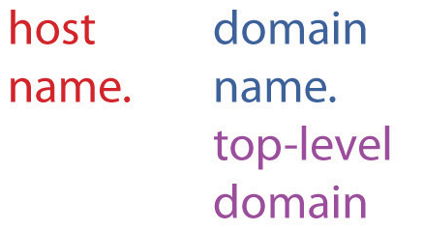
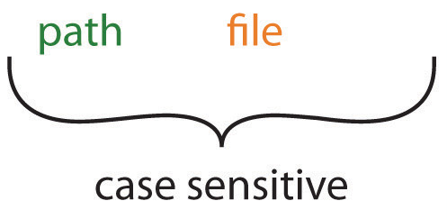
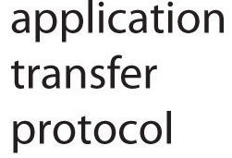
WWW- The Web
A web page can be accessed by entering a URL address into a web browser's address bar.

Slide 14

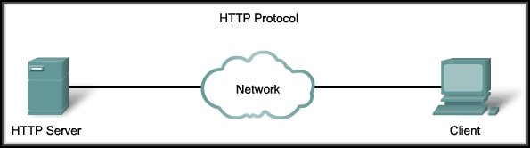
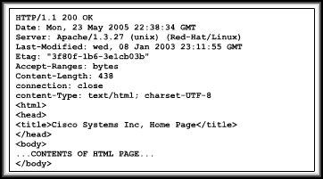

HTTP
HTTP Protocol
HTTP request
Web Server
HTTP response
Web Browser
Web browsers are the client applications used to interpret the HTTP application protocol received from a web server.

Slide 15
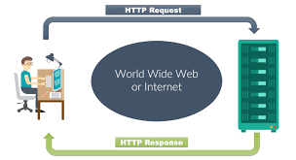
HTTP messages
Two types of HTTP messages:
HTTP Request message
HTTP Response message

Slide 16
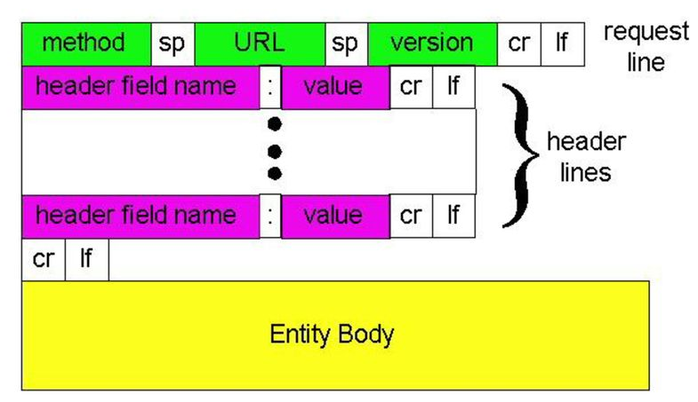
HTTP request message format
HTTP request message:
ASCII (human-readable format)
carriage return character
line-feed character

Slide 17
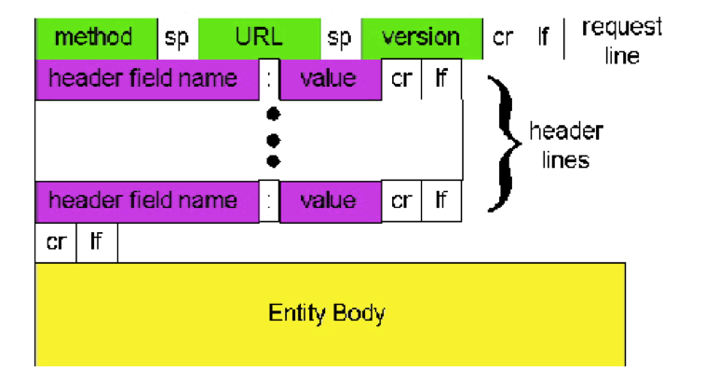
HTTP request message: Example
request line
(GET, POST,
HEAD,PUT,DELETE
commands)
GET //somedir/index.html HTTP/1.1\r\n
Host: www.someschool.edu\r\n
User-Agent: Firefox/3.6.10\r\n
Accept: text/html,image/gif, image jpeg\r\n
Accept-Language: fr \r\n
Connection: close\r\n
\r\n
header
lines
carriage return,
line feed at start
of line indicates
end of header lines

Slide 18
HTTP Method types
HTTP/1.1:
GET, POST, HEAD
PUT/PATCH
Update data
Replaces existing objects
DELETE
Deletes data
HTTP/1.0:
GET
Primarily gets information only
Retrieve data
POST
Creating new data
HEAD
Also retrieve but asks server to leave requested object out of response

Slide 19
Uploading form input
POST method:
Web page often includes form input
Input is uploaded to server in entity body
URL method:
Uses GET method
Input is uploaded in URL field of request line:
www.somesite.com/animalsearch?monkeys&banana

Slide 20
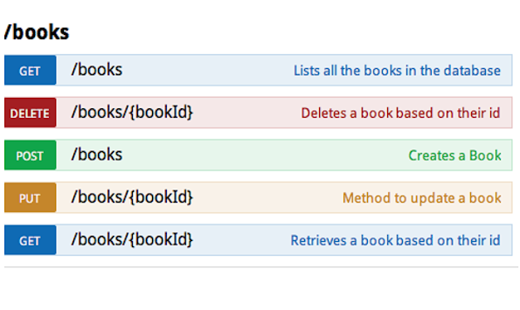
HTTP Methods
Source :https://javarevisited.blogspot.com/2016/04/what-is-purpose-of-http-request-types-in-RESTful-web-service.html

Slide 21
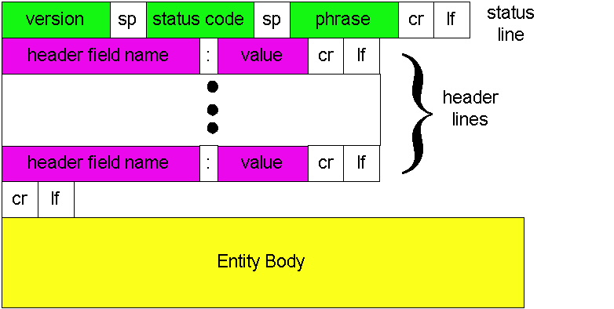
HTTP response message: General Format

Slide 22
HTTP response message : Example
Status line
(protocol
status code
status phrase)
HTTP/1.1 200 OK\r\n
Date: Sun, 26 Sep 2010 20:09:20 GMT\r\n
Server: Apache/2.0.52 (CentOS)\r\n
Last-Modified: Tue, 30 Oct 2007 17:00:02 GMT\r\n
ETag: "17dc6-a5c-bf716880"\r\n
Accept-Ranges: bytes\r\n
Content-Length: 2652\r\n
Keep-Alive: timeout=10, max=100\r\n
Connection: close\r\n
Content-Type: text/html; charset=ISO-8859-1\r\n
\r\n
data data data data data ...
Header
lines
data, e.g.,
requested
HTML file

Slide 23
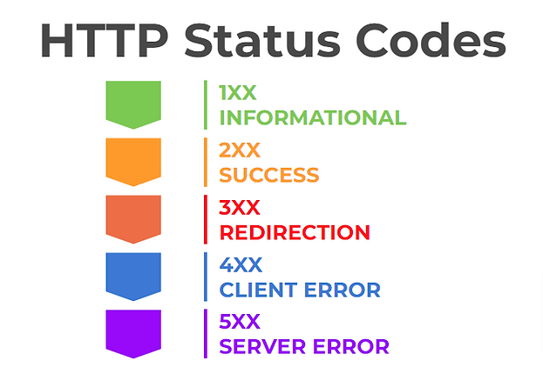
HTTP response status codes
Status code appears in 1st line in server-to-client response message.
HTTP Status codes:

Slide 24
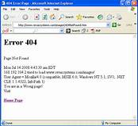
HTTP response status codes
Some sample codes:
100 Continue
everything ok so far, client should continue with the request
200 OK
request succeeded, requested object later in this message
301 Moved Permanently
requested object moved, new location specified later in this message (Location:)
400 Bad Request
request message not understood by server
404 Not Found
requested document not found on this server
505 HTTP Version Not Supported

Slide 25
Objectives -Part 3
HTTP Connections
Non Persistent
Persistent

Slide 26

HTTP Connections
Suppose user enters URL:
(contains text,
references to 10
jpeg images)
www.someSchool.edu/someDepartment/home.index
1a. HTTP client initiates TCP connection to HTTP server (process) at www.someSchool.edu on port 80
1b. HTTP server at host www.someSchool.edu waiting for TCP connection at port 80. “accepts” connection, notifying client
2. HTTP client sends HTTP request message (containing URL) into TCP connection socket. Message indicates that client wants object someDepartment/home.index
3. HTTP server receives request message, forms response message containing requested object, and sends message into its socket
time

Slide 27
HTTP Connections (cont.)
4. HTTP server closes TCP connection.
5. HTTP client receives response message containing html file, displays html. Parsing html file, finds 10 referenced jpeg objects
6. Steps 1-5 repeated for each of 10 jpeg objects
time
Non-persistent HTTP

Slide 28
Non-persistent HTTP: response time
RTT (Round Trip Time): time for a small packet to travel from client to server and back
HTTP response time:
One RTT to initiate TCP connection
One RTT for HTTP request and first few bytes of HTTP response to return
File transmission time
Non-persistent HTTP response time =
2*RTT+ file transmission time
Initiate TCP
connection
RTT
Request
file
RTT
Time to
transmit
file
File
received
time
time

Slide 29
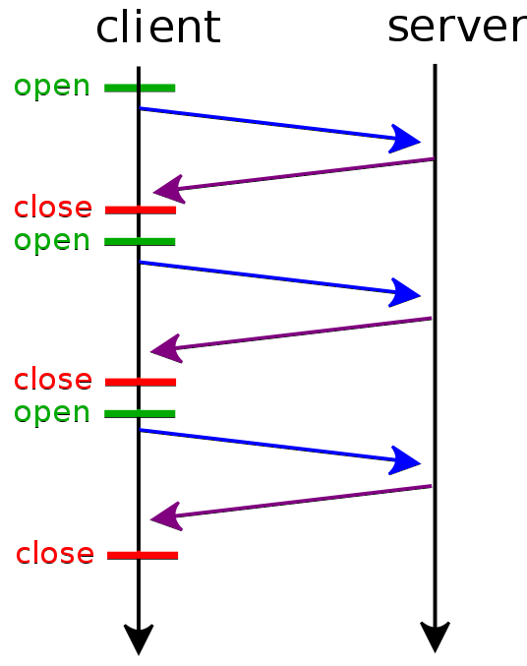

HTTP connections
Non-persistent HTTP
At most one object sent over TCP connection
Connection is then closed
Downloading multiple objects required multiple connections
open ---–TCP Connection Request
close ---– TCP Termination Request

Slide 30
HTTP Transmission Calculation
You wish to access the web page "www.games.com", so you write the URL in your web browser. The Web page associated with the link contains exactly 10 object/s in total. Each object size is 10 MB.
Let 25 ms denote the time required to send a TCP request from PC to server.
Assuming 100 Mbps the transmission speed of the web server
Non-persistent HTTP is being used.
Please calculate the total time in ms that will take the web browser to load your page.

Slide 31
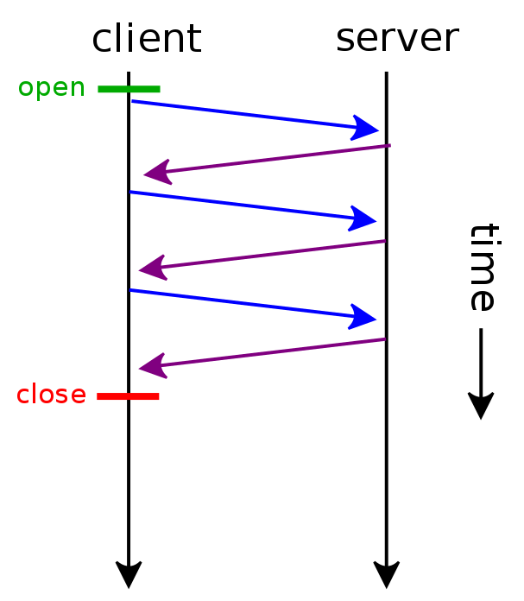
HTTP connections
Persistent HTTP
Multiple objects can be sent over single TCP connection between client, server
open ---–TCP Connection Request
close ---– TCP Termination Request

Slide 32
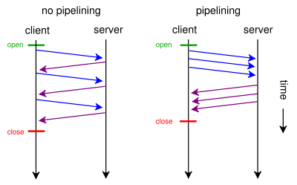
HTTP connections

Slide 33
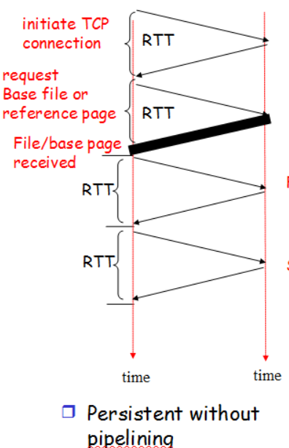
Persistent HTTP
Non-persistent HTTP issues:
Requires 2 RTTs per object
OS overhead for each TCP connection
Browsers often open parallel TCP connections to fetch referenced objects
Persistent HTTP:
Server leaves connection open after sending response
Subsequent HTTP messages between same client/server sent over open connection
Client sends requests as soon as it encounters a referenced object
As little as one RTT for all the referenced objects
2nd object
3rd object

Slide 34

COOKIES
Part 4

Slide 35
Objectives -Part 4
Stateless HTTP
Cookies
Example of how cookies operate
Issues related to cookies

Slide 36
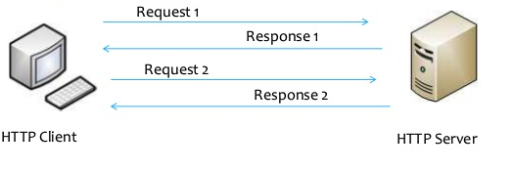
Stateless HTTP
Do not remember previous request response chain.
Protocols that maintain “state” are complex!
Past history (state) must be maintained
If server/client crashes, their views of “state” may be inconsistent, must be reconciled
HTTP is “stateless”
Server maintains no information about past client requests

Slide 37
User-server state: cookies
Many Websites use cookies
Four components:
1) Cookie header line of HTTP response message
2) Cookie header line in next HTTP request message
3) Cookie file kept on user’s host, managed by user’s browser
4) Back-end database at Web site
Example:
Susan always access Internet from PC
Visits specific e-commerce site for first time
When initial HTTP requests arrives at site, site creates:
Unique ID
Entry in backend database for ID

Slide 38



Cookies: keeping “state” (cont.)
ebay 8734
Usual HTTP Request
Server creates ID for user 1678
Entry in backend database
Usual HTTP Response
Set-cookie 1678
Amazon 1678
ebay 8734
Usual HTTP Request
Cookie : 1678
Access
Amazon Server
Cookie specific action
Usual HTTP Response
Cookie : 1678
time
time

Slide 39
Cookies: keeping “state” (cont.)
One week later
Usual HTTP Request
Cookie : 1678
Amazon 1678
ebay 8734
Cookie specific action
Access
Usual HTTP Response
Cookie 1678
Amazon Server
Amazon 1678
ebay 8734
time
time

Slide 40
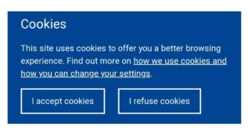
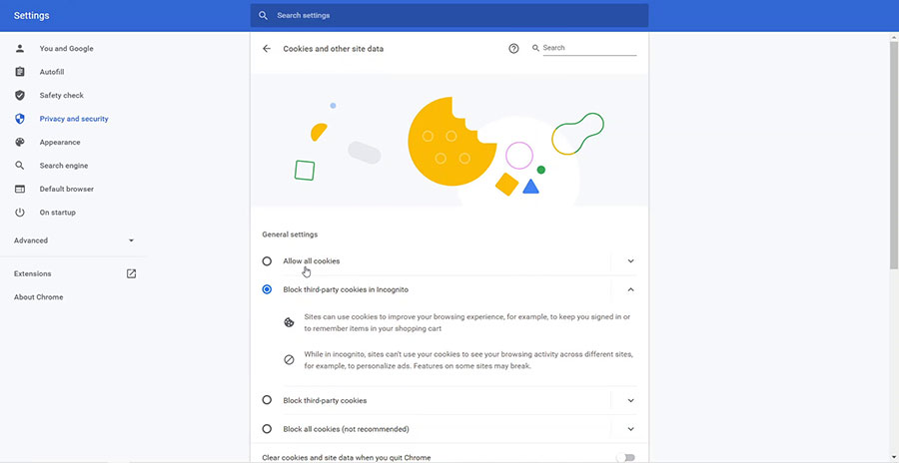
Cookies (continued)
What cookies can be used for:
Authorization
Shopping carts
Recommendations
User session state (Web email)
aside
Cookies and privacy:
Cookies permit sites to learn a lot about you
You may supply name and email to sites
How to keep “state”:
Protocol endpoints: maintain state at sender/receiver over multiple transactions
Cookies: http messages carry state

Slide 41
Web Cache or Proxy Server
Part 5

Slide 42
Objectives - Part 5
What is a Web Cache (Proxy Servers)?
Advantages of Web Cache
Web Caching Example
Problems of Web Caching
Conditional-GET

Slide 43

Web caches (proxy server)
Goal: Satisfy client request without involving origin server
User sets browser: Web accesses via cache
Browser sends all HTTP requests to cache
Object in cache: cache returns object
Else cache requests object from origin server, then returns object to client
proxy
server
HTTP request
HTTP request
client
origin
server
HTTP response
HTTP response
HTTP request
HTTP response
client

Slide 44
More about Web caching
A Proxy Server acts as both client and server
Server for original requesting client
Client to origin server
Typically Proxy Servers are installed by ISPs
University
Company
Residential ISP

Slide 45
Advantages of Web Caching
Reduce response time for client request
Saves bandwidth (prevents downloading of same content multiple times)
Helps log usage, block unwanted traffic
Internet dense with caches:
enables “poor” content providers to effectively deliver content (so too does P2P file sharing)

Slide 46


Caching example:
Assumptions:
Avg object size: 1 Mbits
Avg request rate from browsers to origin servers: 15/sec
Institutional Bandwidth: 100 Mbps
RTT from institutional router to any origin server: 2 sec
Access link rate: 15 Mbps
origin
servers
Public
Internet
HTTP request
15 Mbps
access link
HTTP request
HTTP request
Institutional
network
100 Mbps LAN

Slide 47
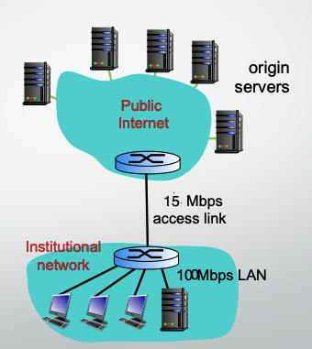
Caching example:
Assumptions:
Avg object size: 1 Mbits
Avg request rate from browsers to origin servers:15/sec
RTT from institutional router to any origin server : 2 sec
What is the average response time?
Average response time = LAN Delay + Access Delay + Internet Delay
Traffic Intensity on LAN = (Avg Req/sec * Avg Obj Size)/Transmission Link Bandwidth
=(15*1000000) / 100000000= 0.15
Traffic intensity on the Access Link = (15*1000000)/ (15*1000000)= 1
Internet Delay = 2 sec (RTT)
Consequences:
LAN utilization: 15%
Access link utilization = 100%

Slide 48
Caching example: Solution
What is the average response time?
Average response time = LAN Delay + Access Delay + Internet Delay
Consequences:
LAN utilization: 15%
Access link utilization = 100%
Delay is in tens of msecs
Delay is in of minutes.
Delay is 2 secs.
Solution of reducing delay:
Increase the bandwidth of the access link.
Install a web cache or proxy server at the institutional network.

Slide 49
Caching example: Solution 1
Assumptions:
Avg object size: 100K bits
Avg request rate from browsers to origin servers:15/sec
RTT from institutional router to any origin server: 2 sec
Access link rate: 15 Mbps
Consequences:
LAN utilization: 15%
Access link utilization = 100%
100 Mbps
Access Link
100 Mbps
15%
Average response time = LAN Delay + Access Delay + Internet Delay
= msecs + mins + 2 secs
msecs
LAN Delay and Access delay becomes negligible
Cost: increased access link speed (not cheap!)

Slide 50
Caching example: Solution 2
Assumptions:
Average hit rate: 40%
Consequences:
LAN delay = within 10 milliseconds
Access delay = tens of milliseconds in a 15 Mbps Link
Total Response time:
origin
servers
public
Internet
15 Mbps
access link
= 0.4(0.01 seconds)+0.6(0.01+ 2 seconds)
= 1.2 secs
institutional
network
100 Mbps LAN
local web
cache
Cost: web cache (cheap!)

Slide 51
Stale Cache
One problem of using Proxy server
The object housed in the Web server may have been modified since the copy was cached at the client.
HTTP has a mechanism that allows a cache to verify that its objects are up to date.
This mechanism is called the conditional GET.
An HTTP request message is a so-called conditional GET message if
The request message uses the GET method
The request message includes an If-Modified-Since: header line.

Slide 52
Conditional GET
proxy server
server
Goal: Don’t send object if cache has up-to-date cached version
No object transmission delay
Lower link utilization
Cache: specify date of cached copy in HTTP request
If-modified-since: <date>
Server: response contains no object if cached copy is up-to-date:
HTTP/1.0 304 Not Modified
HTTP request msg
If-modified-since: <date>
object
not
modified
before
<date>
HTTP response
HTTP/1.0
304 Not Modified
HTTP request msg
If-modified-since: <date>
object
modified
after
<date>
HTTP response
HTTP/1.0 200 OK
<data>

Slide 53
Different versions of HTTP
Part 6

Slide 54
HTTP/2
Key goal: decreased delay in multi-object HTTP requests
HTTP1.1: introduced multiple, pipelined GETs over single TCP connection
server responds in-order (FCFS: first-come-first-served scheduling) to GET requests
with FCFS, small object may have to wait for transmission (head-of-line (HOL) blocking) behind large object(s)
Notes:
t’

Slide 55
HTTP/2: mitigating HOL blocking
HTTP 1.1: client requests 1 large object (e.g., video file) and 3 smaller objects
server
GET O₄
GET O₃
GET O₂
GET O₁
object data requested
client
O₁
O₂
O₁
O₃
O₂
O₃
O₄
O₄
objects delivered in order requested: O₂, O₃, O₄ wait behind O₁
Notes:
t’

Slide 56
HTTP/2
Key goal: decreased delay in multi-object HTTP requests
HTTP/2: [RFC 7540, 2015] increased flexibility at server in sending objects to client: methods, status codes, most header fields unchanged from HTTP 1.1
Multiplexing: divide objects into frames, schedule frames to mitigate HOL blocking
Server Push: Enables servers to send resources proactively; useful for assets that the server knows the client will need (e.g., stylesheets or images)
Stream Prioritization: Allows clients to prioritize requests, letting the server know the order in which the client prefers to receive responses.
Notes:
t’

Slide 57
HTTP/2: mitigating HOL blocking
HTTP/2: objects divided into frames, frame transmission interleaved
server
GET O₄
GET O₃
GET O₂
GET O₁
object data requested
client
O₂
O₄
O₃
O₁
O₂
O₃
O₄
O₁
O₂, O₃, O₄ delivered quickly, O₁ slightly delayed
Notes:
shortest job first: decreased average delay!

Slide 58
HTTP/2 to HTTP/3
HTTP/2 over single TCP connection means:
no security over vanilla TCP connection
HTTP/3:
Built on QUIC: Utilizes QUIC (over UDP) to manage connections, reducing latency via integrated transport and security protocols.
Connection Migration: Supports changes in the client's network connection (e.g., switching from Wi-Fi to cellular) without needing to restart sessions.
Notes:
t’

Slide 59
HTTPS
Part 6

Slide 60
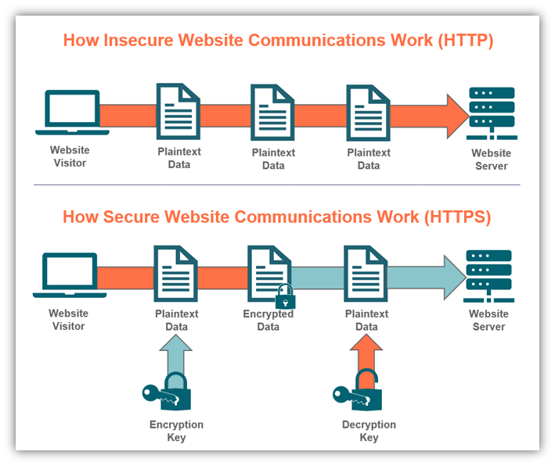
HTTPS
More secure version of HTTP
Allows transferring the data in an encrypted form.
Uses an encryption protocol known as Transport Layer Security, and officially, it is referred to as a Secure Sockets Layer (SSL).
HTTPS transmits the data over 443 port number.

Slide 61

HTTPS
Websites to have an HTTPS protocol, need to install the signed SSL certificate.
The SSL protocol encrypts the data which the client transmits to the server.
This digital certificate is a file that contains
Information about the organization to help it authenticate
Cryptographic information that helps site users communicate with it securely through encryption.
It is a transport layer protocol.
SEO Advantage : GOOGLE gives the preferences to those websites that use HTTPS rather than the websites that use HTTP.

Slide 62
THE END

